Slide 1

LIBRARY MANAGEMENT SYSTEM

Slide 2
INDEX
TEAM MEMBERS
INTRODUCTION
PROJECT DESCRIPTION
ARCHITECTURE
FLOW CHART
SCREENSHOTS
TECHNOLOGIES USED
SCENARIOS

Slide 3
TEAM MEMBERS
Samarpanrao Pedapudi (EMPID:6572)
Junaid Ahmed Baig (EMPID:6576)
Aligeti Sai Kiran Reddy (EMPID:6568)
Konchada Sai Harini (EMPID:6566)
Shameer Sharif Shaik (EMPID:6578)

Slide 4
INTRODUCTION
The Library Management System can handle all the details about a Library
The details include library details, book details, author details, year of publishing details etc.,
The library Management System is an automated version of manual library Management System.

Slide 5
PROJECT DESCRIPTION
Maintaining a written record of library by a single person is a hard thing to do. In customer perspective it is difficult to approach libraries and make sure that their record of buying or renting of a book is accurate.
This project helps in maintaining the database of the books and the people who got registered with the particular library.
We can easily access any book information anytime with ease and can be kept safely for long period of time without any damage.
The library management system allows authorized members to access the record of books which got registered in it and people who got registered in it.
It can be done through registering into the site and logging in it gives the required information.

Slide 6
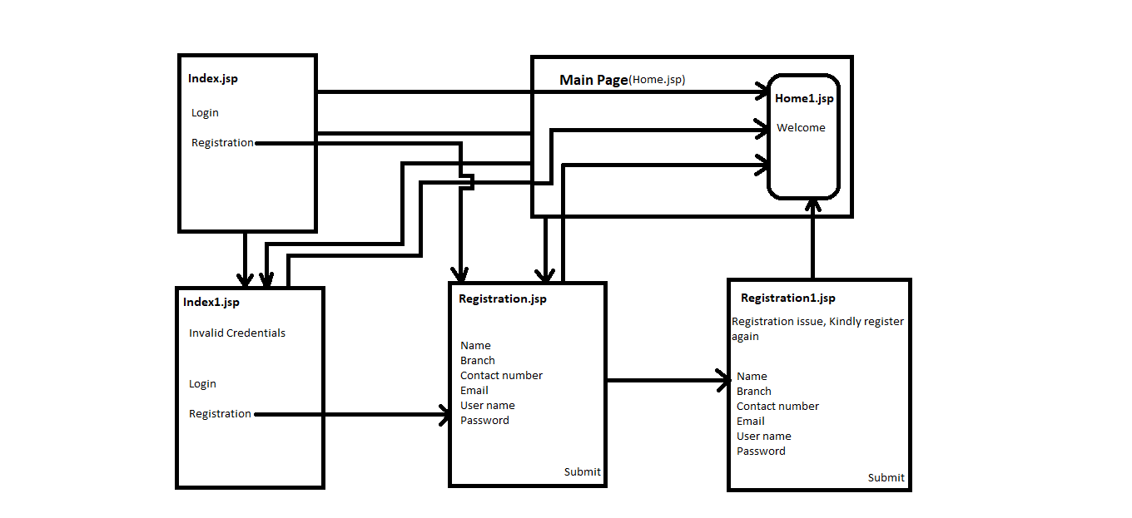
ARCHITECTURE

Slide 7


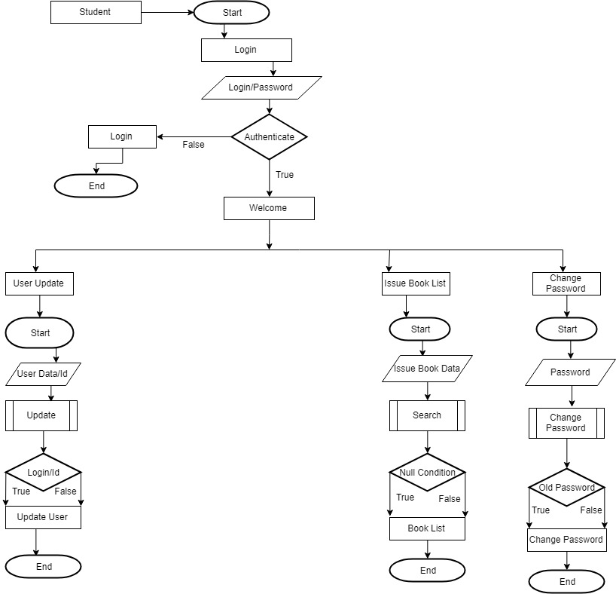

FLOW CHART

Slide 8
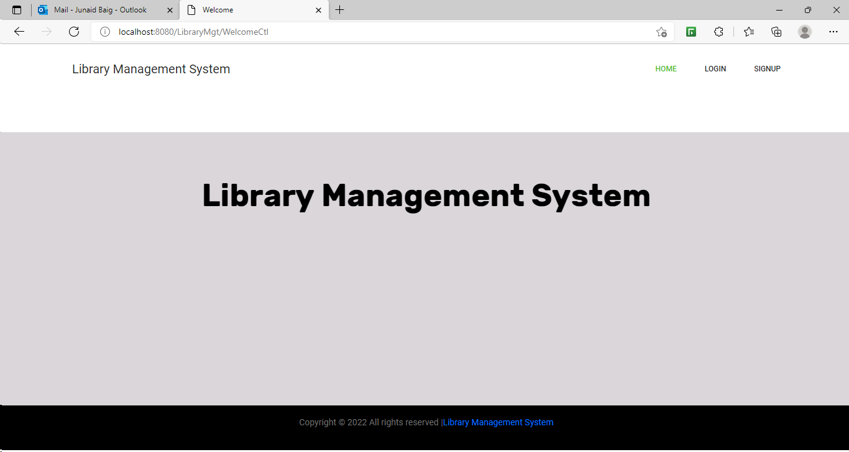
HOME PAGE

Slide 9



TECHNOLOGIES USED

Slide 10
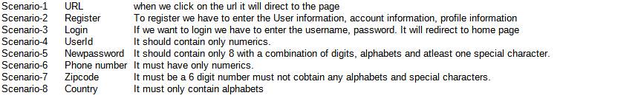
SCENARIOS

Slide 11




THANK YOU

